Slide 1


Naloxone in the Workplace
Dawn Cole
Lake County General Health District

Slide 2

Discussion Topics
What are opioids?
What is Naloxone?
The Opioid Epidemic
Naloxone in the Workplace
Project DAWN

Slide 3
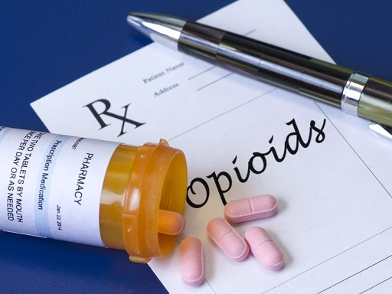
What are Opioids/Opiates?
Opioids are pain-relieving drugs that interact with opioid receptors on nerve cells in the body and brain.
Opioids are generally safe when taken for a short time as prescribed by a doctor.
Opioids are frequently misused because, in addition to pain relief, they produce euphoria.
Regular use of opioids, even as prescribed by a doctor, can produce dependence.
When misused or abused, opioid pain relievers can lead to fatal overdose.
Notes:
Feeling of well-being and elation.

Slide 4
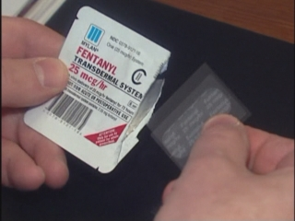
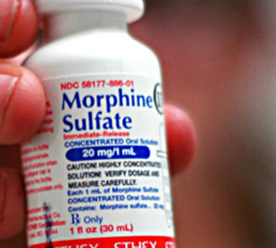
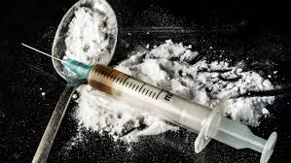
Examples of Opioids
Carfentanil
Codeine
Demerol
Dilaudid
Fentanyl
Heroin
Hydrocodone (Vicodin®)
Methadone
Morphine
Oxycodone (OxyContin®)
Tramadol
Notes:
Opiates are drugs derived from opium. At one time "opioids" referred to syntheticopiates only (drugs created to emulate opium, however different chemically). Now the term Opioid is used for the entire family of opiates including natural, synthetic and semi-synthetic.

Slide 5
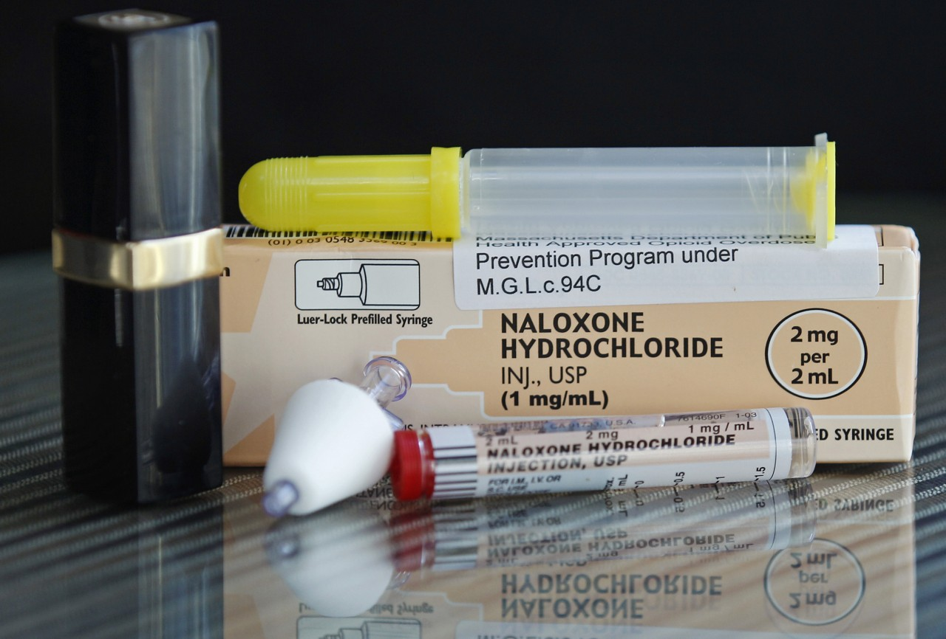
What is naloxone (Narcan®)?

Slide 6
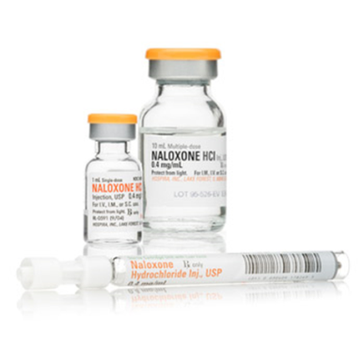
What is Naloxone?
Naloxone (also known as Narcan) is a medication that can reverse an overdose caused by an opioid drug.
Naloxone blocks the effects of opioids on the brain and restores breathing.
Naloxone has been used safely by emergency medical professionals for more than 40 years and has only this one critical function: to reverse the effects of opioids in order to prevent overdose death.
Naloxone has no potential for abuse.

Slide 7
What is Naloxone?
If naloxone is administered to a person who is dependent on opioids, it will produce withdrawal symptoms. Withdrawal, although uncomfortable, is not life-threatening
Naloxone does not reverse overdoses that are caused by non-opioid drugs, such as cocaine, ecstasy, benzodiazepines (e.g. Xanax, Klonopin and Valium), methamphetamines, LSD, GHB, Ketamine, other club drugs, steriods, or alcohol.

Slide 8

Deeper look at opioid Epidemic

Slide 9

Drug overdose in Ohio
In 2007, drug overdose became the leading cause for unintentional injury death in Ohio
Drug overdose fatalities cost Ohioans $4.9 million each year in direct medical costs.
On average, six people die every day in Ohio due to drug overdose
75% of overdose deaths in Ohio involve an opioid

Slide 10

Drug Overdose in Ohio
OHIO LEADS THE NATION IN OPIOID OVERDOSE DEATHS
  Ohio has the country’s most deaths related to heroin – 1 in 9 heroin deaths across the USA happened in Ohio.
  Ohio also recorded the most deaths from synthetic opioids – 1 in 14 USA deaths.

Slide 11
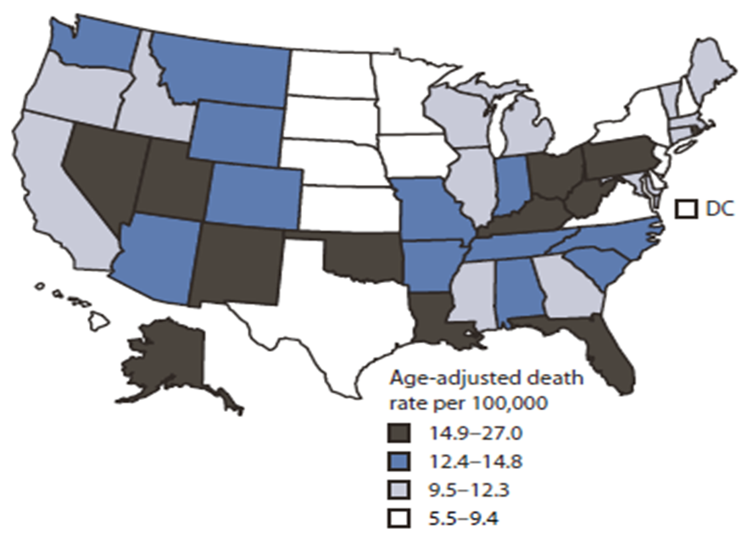
We’re in the midst of a national opioid overdose epidemic.
Opioids (including prescription and illicit opioids) killed more than 33,000 Americans in 2015 – which was nearly quadruple the number from 2000. (Center for Disease Control and Prevention Foundation)

Slide 12
How much is 33,000?
Population of Lake County, Ohio
Comparison
230,041 (2010 Census)
33,000 is 13% of Lake County, Ohio’s entire population
That’s a little more than the entire populations of Willoughby (22,268) North Madison (8547), Perry (1663) and Waite Hill (471) combined!

Slide 13
Speaking of Lake County, Ohio….
In 2015, there were 42 unintentional drug-related deaths (18.2%) in Lake County.
While 71% of accidental deaths involved more than one drug, opioids were involved in 40 of the 42 deaths (95%) (25 – Heroin; 15 – Fentanyl)
71% of Lake County drug overdose deaths were males; 29% were females.
All of the 42 deaths were Caucasian.
(Lake County Unintentional Drug Overdose Deaths/Poisonings 2015 – Lake County General Health District)
Notes:
The Opioid Epidemic does not discriminate – it preys on people of any age, race, educational level and economic status.

Slide 14
How do opioids affect the workplace?
In 2011, approximately 25 percent of workers’ compensation prescription drug claim costs were for opioids (CDC Foundation).
  Prescription opioid use may impact a person’s ability to return to work.
  Workers under the influence of opioids are at increased risk of injury
70% of businesses report that prescription opioid abuse affects their workers (National Safety Council).
The estimated lost productivity for people in the United States with opioid use disorder totaled $20.4 billion in 2013 (CDC Foundation).

Slide 15
How do opioids affect the workplace?
Opioids:
  Cause fatigue and inactivity to the point that muscles become weakened and endurance declines;
  Increase the likelihood of developing sleep disturbances, either insomnia or excessive daytime sleepiness;
  Lead to decreased breathing rate and death due to respiratory depression (overdose)
  (2017 Ohio Safety Congress)

Slide 16

What can a workplace do?

Slide 17

Naloxone is one evidence-based practice aimed at reducing opioid overdose.
Notes:
The reasons behind the opioid epidemic are many and multi-faceted. We don’t tout naloxone as the solution to the opioid epidemic, but it should be included as part of the plan, as it gives an individual a chance to seek the help they need and become one less statistic.

Slide 18
Ohio Senate Bill 319
Signed January 4, 2017 by Governor Kasich and went into effect on April 6, 2017
Lets Service Entities keep non-patient specific naloxone onsite in case of an emergency
Service Entities must have a protocol signed by a physician or board of health to authorize storage and use of naloxone.
Service Entities can purchase naloxone from any wholesaler – they are exempt from the requirement of having a Terminal Distributor of Dangerous Drugs license
First Responders (Police, Fire, EMS, etc.) may transfer supplies of naloxone. The transfer must be documented (NDC, lot number, agency, date) in case of recall
Notes:
A Terminal Distributor of Dangerous Drugs (TDDD) is a person (individual, partnership, association, limited liability company, corporation or government agency) who is engaged in the sale of dangerous drugs at retail, or any person, other than a wholesale distributor or a pharmacist, who has possession, custody, or control of dangerous drugs for any purpose other than for that person’s own use and consumption.
Sites licensed as TDDDs include, but are not limited to, pharmacies, hospitals, nursing homes, emergency medical service organizations, laboratories and all other locations that procure dangerous drugs for sale or other distribution by or under the supervision of a pharmacist or licensed health professional authorized to prescribe drugs.

Slide 19
Ohio Senate Bill 319 –
Service Entity
Examples of Service Entities:
  Schools, Colleges, Universities
  Health Departments
  Community Addiction Services Providers
  Courts
  Probation Departments
  Halfway Houses
  Prisons, Jails
  Community Residential Center, Homeless Shelter
  Manufacturing Facilities
  Etc.
Notes:
The law permits entities, referred to as "Service Entities," that serve individuals who may be at risk of experiencing an opioid-related overdose to procure naloxone for use in emergency situations. It defines "Service Entity" as a public or private entity that provides services to individuals who there is reason to believe may be at risk of experiencing an opioid-related overdose

Slide 20
Ohio Senate Bill 319 –
Legal Protection
Section 4729.514 of the Ohio Revised Code states: A Service Entity or an employee, volunteer, or contractor of a Service Entity is not liable for or subject to any of the following for injury, death, or loss to person or property that allegedly arises from an act or omission associated with procuring, maintaining, accessing, or using naloxone under this section, unless the act or omission constitutes willful or wanton misconduct: damages in any civil action, prosecution in any criminal proceeding, or professional disciplinary action
Always check with your legal counsel concerning liability and other legal issues.

Slide 21

Ohio Senate Bill 319
How does a Service Entity become authorized to administer naloxone?
  A physician/Board of Health must establish a written protocol for administering naloxone.

Slide 22
Ohio Senate Bill 319
Contents of Protocol:
  A description of the clinical pharmacology of naloxone
  Precautions and contraindications concerning the administration of naloxone
  Any limitations concerning the individuals to whom naloxone may be administered
  The naloxone dosage that may be administered and any variation in the dosage based on circumstances specified in the protocol
  Labeling, storage, record-keeping, and administrative requirements
  Training requirements that must be met before an individual can be authorized to administer naloxone
Sample Protocol: www.pharmacy.ohio.gov/serviceprotocol
Notes:
The law permits an employee, volunteer, contractor of a Service Entity to administer naloxone pursuant to the physician-approved protocol.
There is no requirement in the law indicating when the protocol for naloxone administration must be renewed or reviewed.

Slide 23
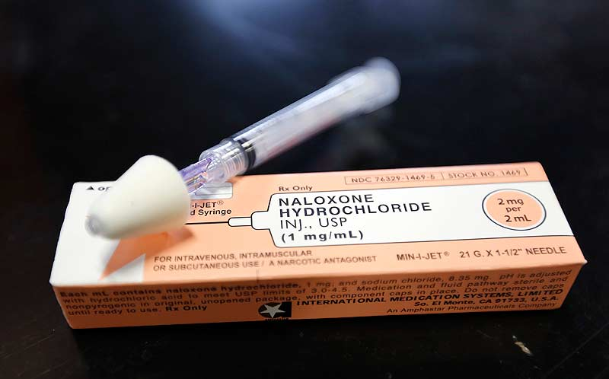
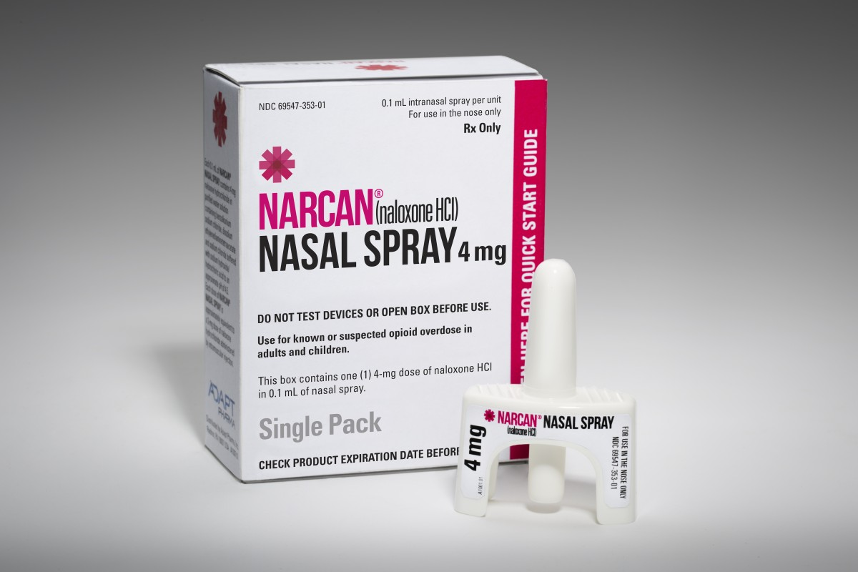
Ohio Senate Bill 319 – Naloxone Procurement
You may order naloxone from a wholesaler that is licensed by the State of Ohio Board of Pharmacy. Ohio License verification: www.pharmacy.ohio.gov/licenselookup
  Let the wholesaler know that, effective April 6, 2017, your organization is exempt from licensure as a terminal distributor of dangerous drugs pursuant to ORC 4729.541.

Slide 24
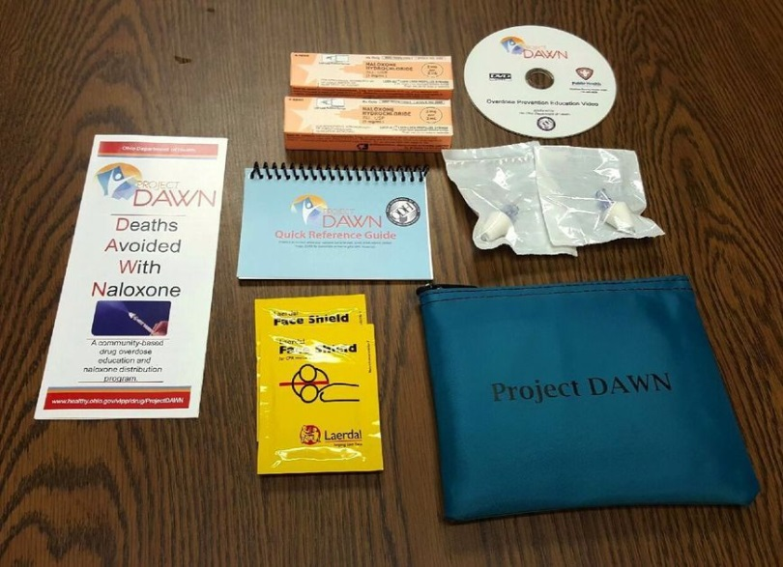
Training – Project DAWN
Lake County General Health District provides training on naloxone administration through Project DAWN
DAWN = Deaths Avoided With Naloxone
Pilot project developed by Ohio Department of Health to reduce opioid overdose fatality
Project DAWN is a community-based overdose education and naloxone distribution program.

Slide 25
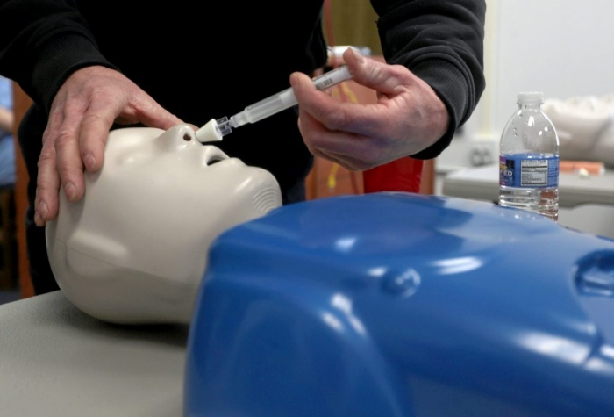

Training – Project DAWN
Project DAWN participants receiving training on:
  Recognizing the signs and symptoms of overdose
  Performing rescue breathing
  Calling emergency medical services
  Administering intranasal Naloxone

Slide 26
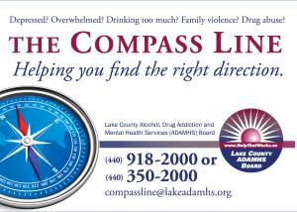
Where to get help in
Lake County

Slide 27
References
CDC Foundation, http://www.cdcfoundation.org/businesspulse/opioid-overdose-epidemic
Henry J. Kaiser Family Foundation, http://kff.org/state-category/health-status/opioids/
Lake County General Health District, Lake County Unintentional Drug Overdose Deaths/Poisonings 2015

Slide 28
References
Ohio Bureau of Workers’ Compensation, https://bwc.expoplanner.com/files/6/SpeakerFiles/726_470_3921_Handout_A_Look_at_the_Impact_of_Opioid_Analgesics_on_the_Body_Systems_OSC_2017.pdf
Ohio Department of Health, https://www.odh.ohio.gov/health/vipp/drug/ProjectDAWN.aspx

Slide 29
References
Ohio Pharmacy Board, https://pharmacy.ohio.gov/Documents/Pubs/Naloxone/Service%20Entity%20Resources/Guidance%20Document%20-%20Naloxone%20for%20Administration%20by%20Service%20Entity%20Personnel.pdf
Ohio Senate Bill 319, https://www.legislature.ohio.gov/download?key=6079&format=pdf

Slide 30
References
National Institute on Drug Abuse, https://www.drugabuse.gov/drugs-abuse/opioids
United States Centers for Disease Control and Prevention, https://blogs.cdc.gov/niosh-science-blog/2015/12/21/opioid-overdose/

Slide 31

Special Thanks
David Frisone, Director, Lake County Narcotics Agency
John Gielink, Chief, Mentor-on-the-Lake Police Department
Dr. Nancy Rodway, Medical Director, Lake County General Health District
Frank Whittaker, Chief, Painesville Township Fire Department

Slide 32

Questions???

Slide 33

Dawn Cole
Lake County General Health District
440-350-2417
dcole@lcghd.org

